Slide 1
SQL PROJECT
Pizza Sale analysis

Slide 2
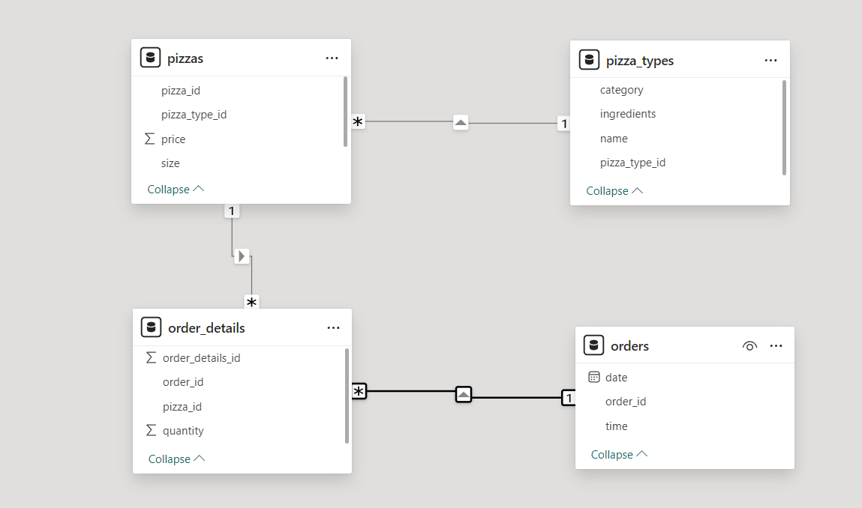
Tables details

Slide 3
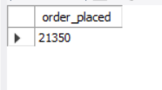
Retrieve the total number of orders placed.
SELECT COUNT(order_id)
AS order_placed
FROM orders;

Slide 4

Calculate the total revenue generated from pizza sales.
SELECT ROUND(SUM(pizzas.price * order_details.quantity),2)
AS revenue
FROM pizzas
LEFT JOIN order_details
ON pizzas.pizza_id = order_details.pizza_id;

Slide 5

Identify the highest-priced pizza.
SELECT pizza_types.name, pizzas.price
FROM pizza_types
JOIN pizzas ON pizza_types.pizza_type_id = pizzas.pizza_type_id
ORDER BY pizzas.price
DESC
LIMIT 1;

Slide 6

Identify the most common pizza size ordered.
SELECT pizzas.size, COUNT(order_details.order_details_id)
AS pizza_counts FROM pizzas
JOIN order_details
ON pizzas.pizza_id = order_details.pizza_id
GROUP BY pizzas.size
ORDER BY pizza_counts DESC
LIMIT 1;

Slide 7
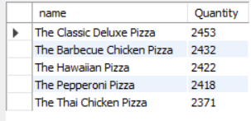
List the top 5 most ordered pizza types along with their quantities.
SELECT pizza_types.name,
SUM(order_details.quantity) AS Quantity
FROM pizza_types JOIN pizzas ON pizza_types.pizza_type_id = pizzas.pizza_type_id
JOIN order_details ON order_details.pizza_id = pizzas.pizza_id
GROUP BY pizza_types.name
ORDER BY Quantity DESC LIMIT 5;

Slide 8
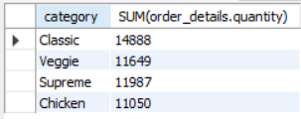
Join the necessary tables to find the total quantity of each pizza category ordered
SELECT pizza_types.category, SUM(order_details.quantity)
FROM pizza_types
JOIN pizzas ON pizza_types.pizza_type_id = pizzas.pizza_type_id
JOIN order_details ON order_details.pizza_id = pizzas.pizza_id
GROUP BY pizza_types.category;

Slide 9
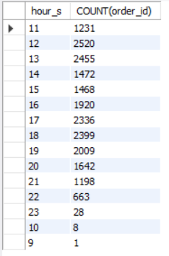
Determine the distribution of orders by hour of the day.
SELECT HOUR(order_time) AS hour_s, COUNT(order_id)
FROM orders
GROUP BY hour_s;

Slide 10

Group the orders by date and calculate the average number of pizzas ordered per day.
SELECT ROUND(AVG(quantity), 0) FROM
(SELECT orders.order_date, SUM(order_details.quantity) AS quantity
FROM orders JOIN order_details ON orders.order_id = order_details.order_id
GROUP BY orders.order_date) AS arg_order;

Slide 11
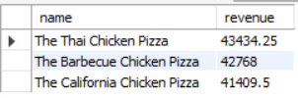
Determine the top 3 most ordered pizza types based on revenue.
SELECT name, SUM(pizzas.price * order_details.quantity) AS revenue FROM pizza_types JOIN pizzas ON pizza_types.pizza_type_id = pizzas.pizza_type_id
JOIN order_details ON order_details.pizza_id = pizzas.pizza_id
GROUP BY name ORDER BY revenue DESC
LIMIT 3;

Slide 12
Calculate the percentage contribution of each pizza type to total revenue
SELECT name, SUM(pizzas.price*order_details.quantity) AS revenuw
FROM pizza_types
JOIN pizzas ON pizza_types.pizza_type_id = pizzas.pizza_type_id
JOIN order_details ON order_details.pizza_id = pizzas.pizza_id
GROUP BY name ORDER BY revenue DESC
LIMIT 3;

Slide 13
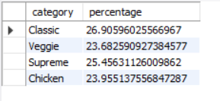

Slide 14
Analyze the cumulative revenue generated over time.
select order_date, sum(rev) over(order by order_date) as cum_feq
from (select o1.order_date,sum(o2.quantity*p1.price) as rev
from order_details o2
join pizzas p1 on p1.pizza_id = o2.pizza_id
join orders o1 on o1.order_id = o2.order_id
group by o1.order_date) as sale;

Slide 15
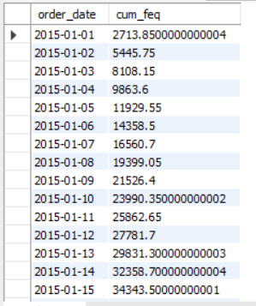

Slide 16
Determine the top 3 most ordered pizza types based on revenue for each pizza category.
select * from (select category,name,revenue, rank() over(partition by category order by revenue desc) as rn From
(select p1.category, p1.name, sum(o1.quantity*p2.price) as revenue
from pizza_types p1
join pizzas p2 on p1.pizza_type_id = p2.pizza_type_id
join order_details o1 on o1.pizza_id = p2.pizza_id group by p1.name,p1.category) as a) as b where rn < 3;

Slide 17
